Slide 1

Fitness Club Membership Management
Database Project: Implementation of a relational database using PostgreSQL.

Slide 2

Project Overview: Fitness Club Database Development
Objective
Scope of Functionality
Implementation
Developed a relational database for comprehensive management of fitness club operations.
Includes management of members, memberships, subscriptions, trainers, classes, attendance, payments, and locker assignments.
All business logic is implemented directly using SQL for integrity and performance.

Slide 3
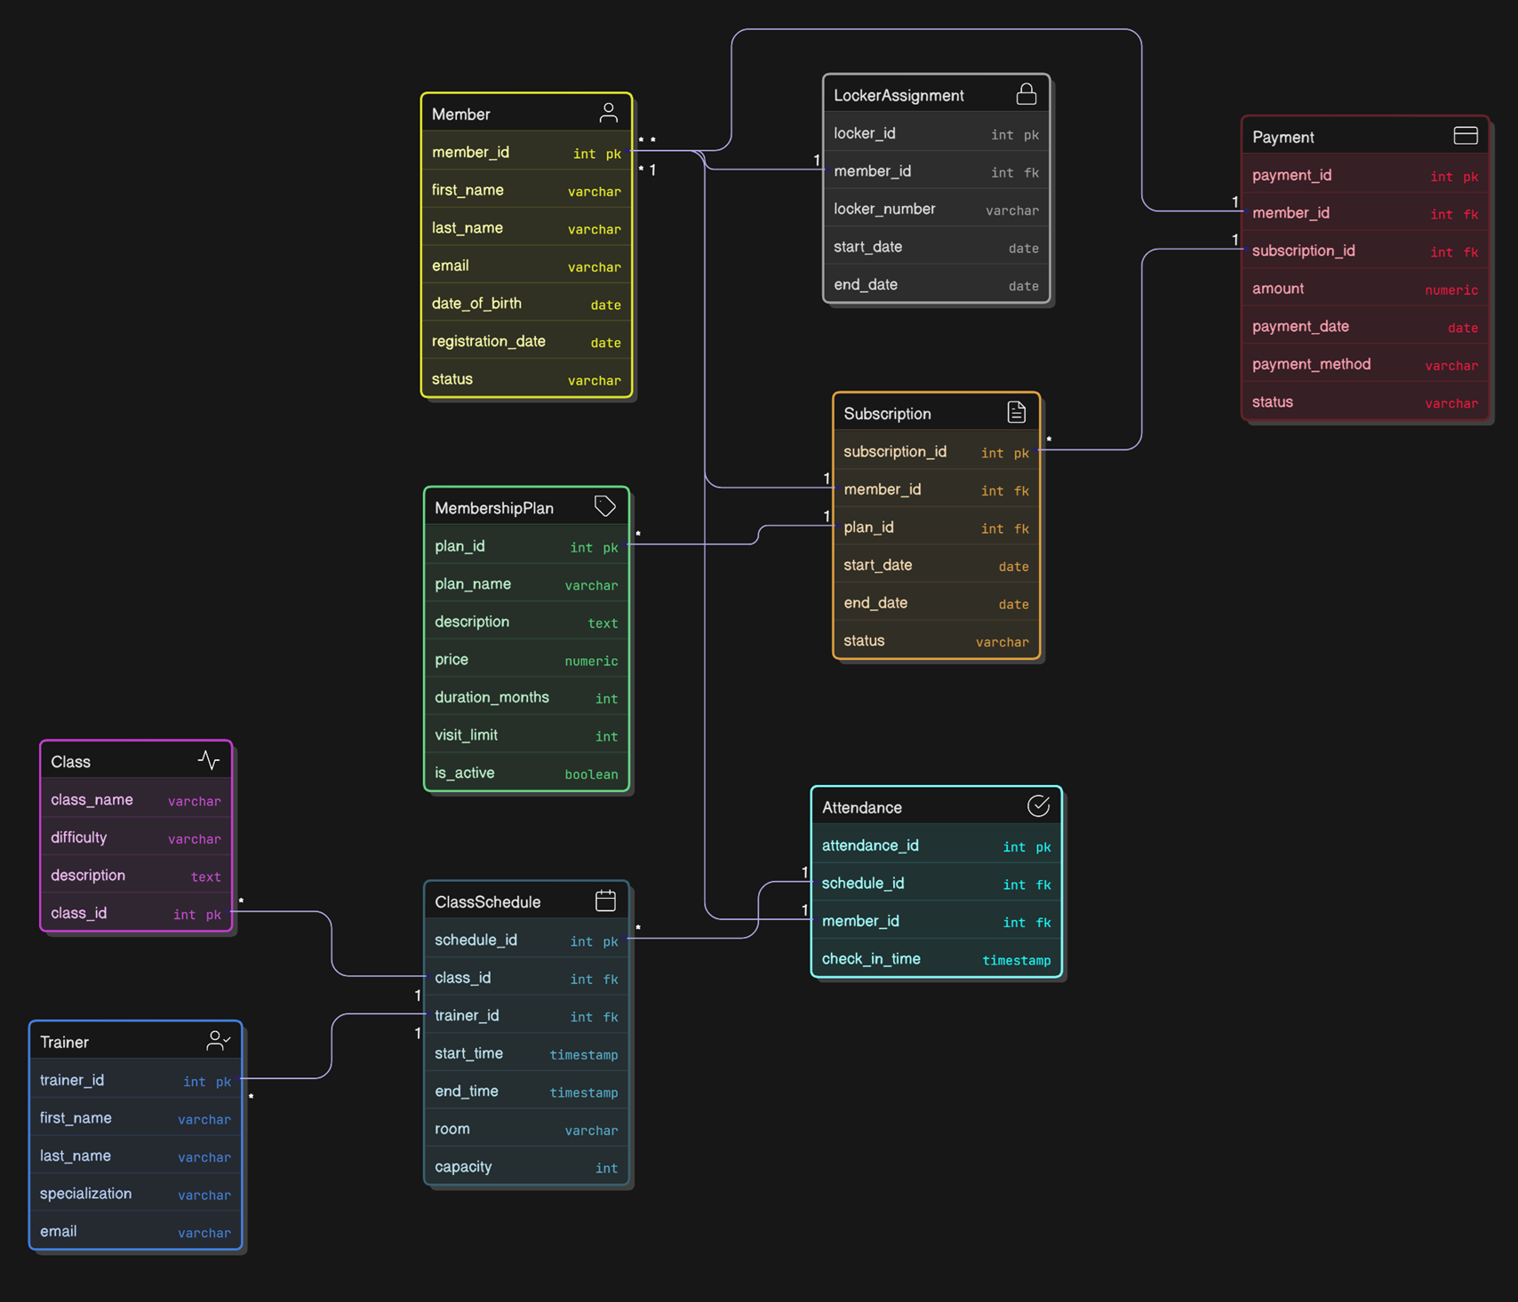
Database Schema: Normalized Structure
The system's foundation is a normalized relational schema,
ensuring data integrity and minimizing redundancy.
Relationships between the 9 main
tables are defined using primary and foreign keys.

Slide 4
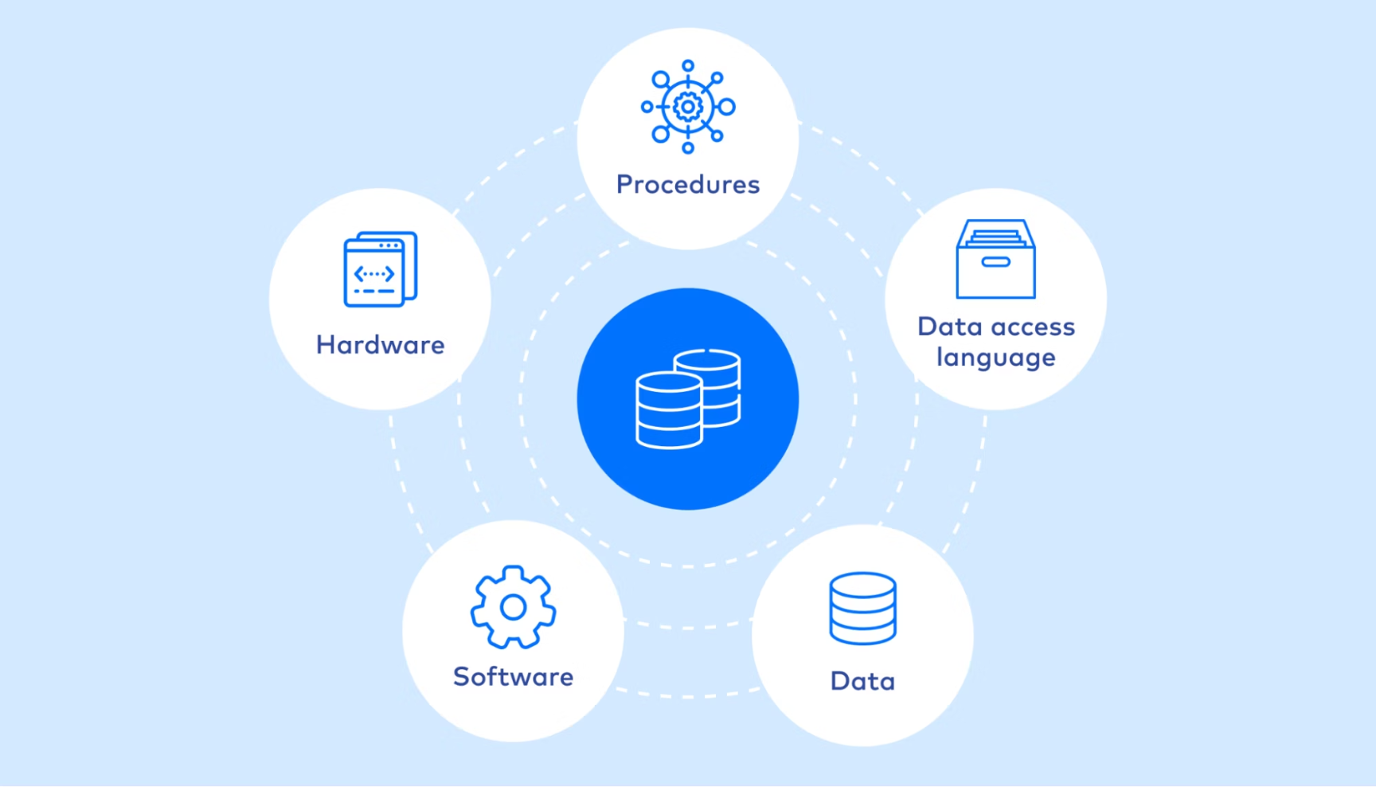
Data Integrity Rules
A comprehensive set of integrity rules has been implemented to ensure data reliability.
Primary Keys: Guarantee the uniqueness of records across all tables.
Foreign Keys: Maintain referential integrity between related tables.
Unique Constraints: Applied to fields such as email and locker assignments per member.
CHECK Constraints:
Positive payment amounts.
Valid date and time ranges.
Positive class capacity.
No duplicate attendance for a member within the same schedule.

Slide 5
Test Data and Its Significance
Realistic test data has been inserted to verify functionality and test queries.
Data Completeness
Meaningful Testing
Realism
The data covers all entities and their relationships, ensuring comprehensive testing.
Allows for meaningful testing of queries and transactions in conditions close to real-world scenarios.
The generated data simulates the behavior of a real fitness club for accurate performance evaluation.

Slide 6
Basic SQL Queries: Retrieving Core Information
Queries have been developed to extract key information about club operations.
List of Active Members
1
Retrieve a list of all members with active subscriptions.
Member Subscriptions and Plans
2
Information on each member's current plans and subscription status.
Class Schedule with Trainers
3
Full schedule of all classes, including information about the lead trainers.
Member Attendance History
4
Detailed record of each member's class attendance.
Payment History
5
Records of all payments made by each club member.

Slide 7
Advanced SQL Queries for Analysis
Using complex SQL constructs for in-depth data analysis and report generation.
Data Aggregation
Advanced Reporting
Using GROUP BY and HAVING for statistical reports.
Reports based on Common Table Expressions (CTE) for complex logic.
Class occupancy and attendance statistics.
Total payment amount for each member.
Window functions for ranking the most active members.

Slide 8

Transactions: Ensuring Operational Integrity
Transactions ensure that multi-step operations are performed atomically, maintaining data integrity.
Start Transaction
BEGIN: Initialization of an operation sequence.
Create Member
INSERT INTO Member ...: Adding a new member.
Create Subscription
INSERT INTO Subscription ...: Associating a member with a plan.
Record Payment
INSERT INTO Payment ...: Recording a financial transaction.
Complete Transaction
COMMIT: Confirming all changes if no errors occur.
The ROLLBACK example demonstrates error handling and maintaining data consistency upon failure.

Slide 9
Indexing: Performance Optimization
Indexes were strategically added to speed up frequently used queries and reports.
Member Fields
Subscriptions
Member's email and last name for quick searches.
Member and subscription status for tracking active memberships.
Schedule
Foreign Keys
Class start time for effective planning.
Keys for attendance and payments to speed up table joins.

Slide 10
Database Views
Views were created to simplify complex queries and provide personalized reports.
Active Members: A list of members with active subscriptions.
Payment Summaries: General information about financial inflows.
Active Subscriptions: Current and pending subscriptions.
Class Occupancy Summary: Overview of class attendance.
Members Without Visits: For identifying inactive users.
Trainer Schedule: Each trainer's availability.
Expired Subscriptions: A list for renewal or deletion.

Slide 11
Question Time!

Slide 12
Thanks for attention!

